Slide 1
GUI Programming and Event-driven Programming
Slides due to Michael Ernst and David Notikin, University of Washington

Slide 2
Announcements
CHECK YOUR GRADES
  Quizzes, HWs, Exams in Submitty
HW8 due now?
HW9 will be out tomorrow, Tuesday
  Will be due APRIL 30th at Midnight

Slide 3
Outline of Today’s Class
Organization of the Java Swing/AWT library
  Components and containers
  Layout managers
  Graphics and drawing
Events
  Event objects
  Event listeners
Anonymous inner classes
Interaction between UI and program threads
Fall 17 CSCI 2600, A Milanova

Slide 4
Why Study GUIs?
Practice design patterns and concepts
  Model View Controller (i.e., Observer), Composite
  Callbacks, inheritance vs. delegation
Learn about event-driven programming
Practice learning and using a large API
There is way more than you can memorize
  First, learn fundamentals and general ideas
  Then, look things up as you need them!
  Don’t get bogged down implementing eye candy

Slide 5
Aside: Callbacks
A callback occurs when library code calls a
user-defined method
class InstrumentedHashSet extends HashSet {
private int addCount = 0;
public InstrumentedHashSet(Collection c) {
super(c);
}
public boolean add(Object o) {
addCount++; return super.add(o);
}
public boolean addAll(Collection c) {
addCount += c.size(); return super.addAll(c);
}
public int getAddCount() { return addCount; }
}
Notes:
InstrumentedHashSet depends on the implementation of HashSet!

Slide 6
Aside: Callbacks
InstrumetedHashSet s=new InstrumentedHashSet();
System.out.println(s.getAddCount()); // 0
s.addAll(Arrays.asList(“One”,”Two”));
System.out.println(s.getAddCount()); // Prints?
A callback
HashSet
… this.add(o);…
add(Object o)
addAll(Collection c)
addCount++; super.add(o);
addCount += c.size();
super.addAll(c);
InstrumentedHashSet
add(Object o)
addAll(Collection c)

Slide 7
References
Sun/Oracle Java Swing tutorial:
  http://docs.oracle.com/javase/tutorial/uiswing/index.html
Core Java by Horstmann and Cornell
Other…
Fall 17 CSCI 2600, A Milanova

Slide 8
Java GUI Libraries
Swing: the main Java GUI library
  Paints GUI components itself pixel-by-pixel
    Does not delegate to the OS window system
  Benefits: expanded set of widgets and features, cross-platform compatibility, OO Design
Abstract Windowing Toolkit (AWT): Sun’s initial GUI library
  Maps Java code to each OS’s windowing system
  Problems: limited set of widgets, clunky to use
Fall 17 CSCI 2600, A Milanova

Slide 9
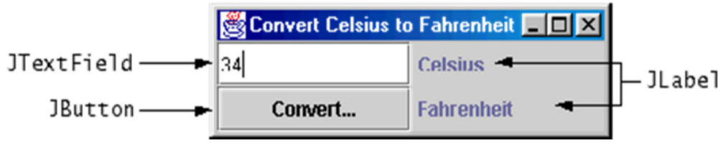
GUI Terminology
window: A first-class citizen of the graphical desktop. E.g., frame
component: A GUI widget that resides in a window. E.g., button, text box, label
container: A component that holds components. What design pattern is this? E.g., panel, box

Slide 10
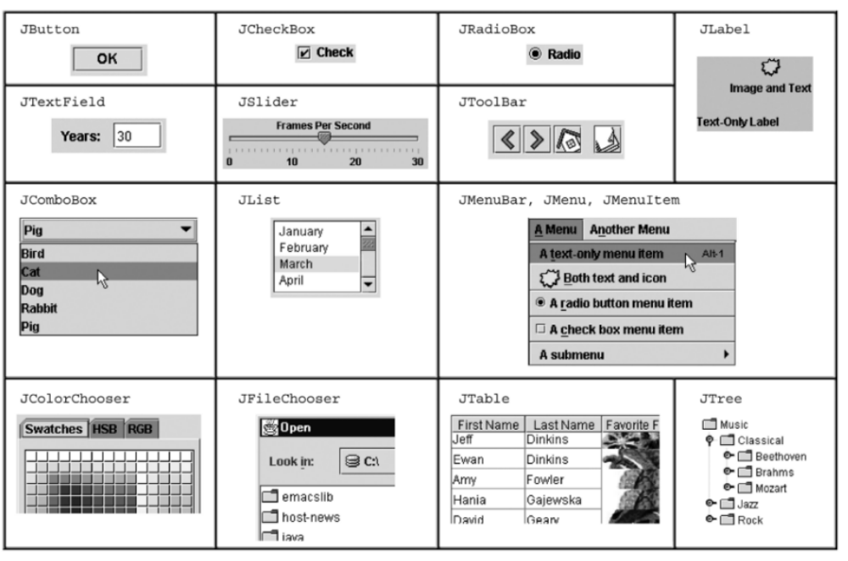
Components

Slide 11
The Component Hierarchy
_x0016_
Containers can hold
nested components
Atomic units, e.g., button,
label, menu item, etc.
Component
_x0016_
_x0016_
Lots of AWT
components
Container
_x0016_
_x0016_
AWT
Containers
JComponent
_x0016_
_x0016_
_x0016_
Lots of other
JComponents
JPanel
JFileChooser

Slide 12
The Component Hierarchy
Component (AWT, java.awt.Component)
Container (AWT, java.awt.Container)
Window
Frame
JFrame (Swing)
JWindow
JComponent (Swing, java.swing.JComponent)
JButton JColorChooser JFileChoser
JComboBox JLabel JList
JMenuBar JOptionPane JPanel
JPopupMenu JProgressBar JScrollBar …

Slide 13
Component Properties
Each property has a get (or is) accessor and a set modifier. E.g., getFont, setFont, isVisible
Example properties
  background – color behind component
  border - border line around component
  enabled – whether it can be interacted with
  focusable – whether key text can be typed on it
  font – font used for text in component
  Etc.

Slide 14
Containers
Windows are top-level containers: JFrame, JDialog
  Live at the top of UI hierarchy, not nested
  Can be used by themselves, but usually as a host for other components
Mid-level containers: JPanel, JToolBar
  Sometimes contain other components, sometimes not
  JPanel is a general-purpose component for drawing or hosting other UI elements
Specialized containers: menus, list boxes…

Slide 15
JFrame – Top-level Container (Window)
Graphical window on the screen
Typically holds other components
Commonly used methods:
  JFrame(String title) – title optional
  setSize(int width, int height)
  add(Component c) – add component to window
  setVisible(boolean v) – don’t forget this!
Fall 17 CSCI 2600, A Milanova

Slide 16
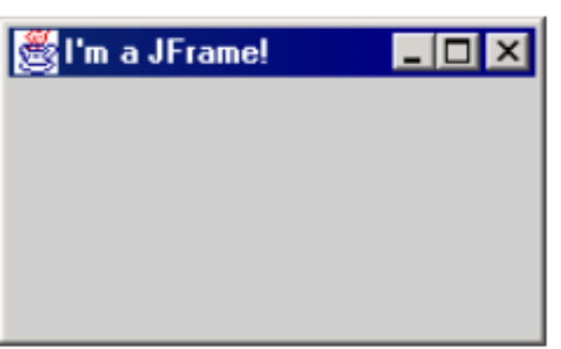
JFrame
setDefaultCloseOperation(int o) – makes the frame perform the given action when it closes
  Common value: JFrame.EXIT_ON_CLOSE
  If not set, program will never exit even if frame is closed. Don’t forget this!
pack() – resizes frame to fit components
Example:…/csci2600/handouts/SimpleFrameMain.java
Fall 17 CSCI 2600, A Milanova

Slide 17
JPanel – a General Purpose Container
Used to group other containers: a place for graphics, or to hold buttons, labels, etc.
Must be added to a frame or other container
  frame.add(new JPanel(…));
JPanels can be nested at any depth
Many methods in common with JFrame. Why?
Some new methods
  E.g., setPreferredSize(Dimension d)
Notes:
There is a subtle difference between setSize() and setPreferredSize(). Worry about preferredSize in context of LayoutManagers.

Slide 18
Layout Managers
Sizing and positioning
Absolute positioning (C++, C#, other)
  Programmer specifies exact pixel coordinates of every component. E.g., “Put this button at (x=15, y=75) and make it 70x31 pixel in size”
Layout managers (Java):
  Objects that decide where to position each component based on some general rules or criteria. E.g., “Put these four buttons into a 2x2 “grid” and put these text boxes in a “horizontal flow” in the “south” part of the frame”

Slide 19
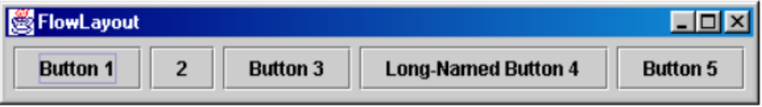
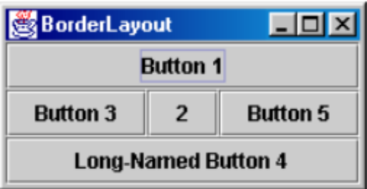
Layout Manager – positions components in container
Each container has a layout manager
FlowLayout (left to right, top to bottom) - default for JPanel
BorderLayout (“center”, “north”, “south”, “east”, “west”) – default for JFrame
Fall 17 CSCI 2600, A Milanova
Notes:
FlowLayout treats container as a left-to-right top-to-bottom “paragraph”
Components are given preferred size, horizontally and vertically

Slide 20
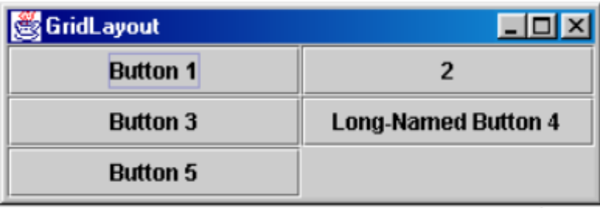
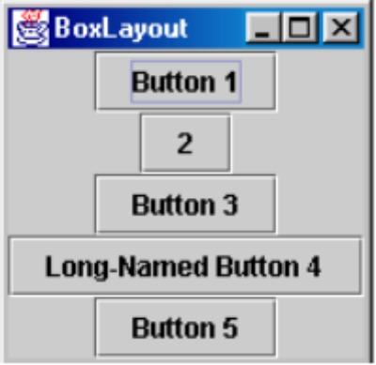
Layout Manager – Positions Components in Container
GridLayout (a 2D grid):
BoxLayout:
Other… Some are very complex
Fall 17 CSCI 2600, A Milanova

Slide 21
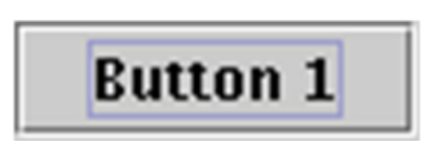
Preferred Sizes
Swing component objects all have a certain size they would like to be: just large enough to fit their contents (text, icons, etc.).
  This is called the preferred size of the component
  Some layout managers (e.g., FlowLayout) size the components inside them to their preferred size
  Others (e.g., BorderLayout, GridLayout) disregard (some dimension of) the preferred size and use some other scheme to size components

Slide 22
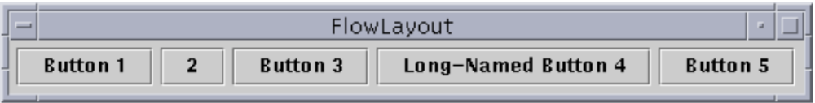
FlowLayout – the Default for JPanel
Treats container as top-to-bottom “paragraph”
  Components have preferred size, horizontally and vertically
  Components are positioned in the order added
  If too long, components wrap around to next line
  myFrame.setLayout(new FlowLayout());
  myFrame.add(new JButton(“Button 1”));

Slide 23
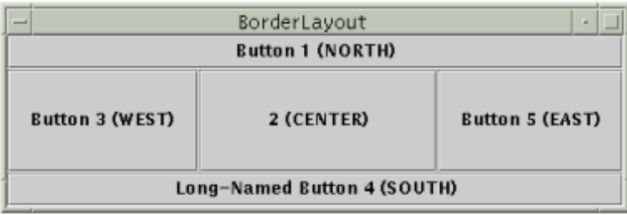
BorderLayout
Divides container into five regions
  NORTH and SOUTH regions expand to fill component horizontally and use the component’s preferred size vertically
  WEST and EAST regions expand to fill region vertically and use the component’s preferred size horizontally
  CENTER uses all space not occupied by others
  myFrame.setLayout(new BorderLayout());
  myFrame.add(new JButton(“Button 1”),
  BorderLayout.NORTH);

Slide 24
JFrame – the top-level container
add(Component c),
add(Component c, Object info)
Add component to the container, possibly giving extra info about where to place it:
frame.add(new Jbutton(“1”), BorderLayout.NORTH);
remove(Component c)
setLayout(LayoutManager mgr)
validate()
validate refreshes the layout (if it changes after container is onscreen). Time-consuming.

Slide 25
General Structure of GUI Application
Place components in a container (JPanel) then add container to frame (JFrame)
Container stores components and governs their positions, sizes and resizing behavior
Fall 17 CSCI 2600, A Milanova

Slide 26
General Structure
Once components are added to their frame
  pack();
  setVisible(true);
pack() figures the sizes of all components and calls the layout manager to set locations in the container (recursively – what pattern?)
If your window doesn’t look right, you may be forgetting pack()
E.g., …csci2600/handouts/SimpleLayoutMain.java

Slide 27
Graphing and Drawing
What if we want to draw something? An image, a path?
Answer: Extend JPanel and override method paintComponent
  Method in JComponent that draws the component
Example: …/csci2600/handouts/SimplePaintMain.java
Fall 17 CSCI 2600, A Milanova
Notes:
So far so good and boring.

Slide 28
Graphics Methods
Many methods to draw various lines, shapes
Can also draw image (pictures, etc.). Load the image file into an Image object and use g.drawImage(…)
  In the program (maybe not in paintComponent):
    Image image = ImageIO.read(file)
  Then in paintComponent:
    g.drawImage(image, … )
Fall 17 CSCI 2600, A Milanova
Notes:
To draw, we use the Graphics toolkit.

Slide 29
Graphics vs. Graphics2D
Graphics is part of the original Java AWT
  Has procedural interface: e.g., g.drawRect(…)
Swing introduced Graphics2D
  Added an OO interface: create instance of Shape, e.g., Line2D, Rectangle2D, etc. Then call draw with respective arg: draw(Shape s)
Argument passed to paintComponent is always a Graphics2D. Can always cast it to that class. Grpahics2D supports both sets of graphics methods. Use whichever you like
Notes:
drawRect takes as arguments x and y, i.e., the coordinates of the top-left corner of the rectangle, as well as the width and height of the rectangle.

Slide 30
Who Calls paintComponent?
The window manager calls paintComponent whenever it wants!!!
  When the window is first made visible and whenever after that it is needed. Never call paintComponent yourself!
Thus, paintComponent must always be ready to repaint – must store all information needed
If you must redraw a window, call repaint()
  Tells the window manager to schedule repainting
  Window manager will call paintComponent when it decides to redraw (soon, but not right away)
Notes:
Draw the interaction.

Slide 31
Rules for Painting. Obey!
Always override
paintComponent(Graphics) if you want to draw a component
Always call super.paintComponent(g) first from your paintComponent(...). Why?
NEVER call paintComponent yourself
Always paint the entire picture from scratch
Fall 17 CSCI 2600, A Milanova

Slide 32
Rules for Painting. Obey!
Use Graphics parameter of paintComponents to do all the drawing. ONLY use it for that. Don’t copy it, try to replace it, permanently side-effect it, etc. It is quick to anger.
DON’T create new Graphics or Graphics2D objects
Fine print: once you are certifiedTM wizard you may find reasons to do things differently, but for now follow the rules

Slide 33
Outline of Today’s Class
Organization of the Java Swing/AWT library
  Components and containers
  Layout managers
  Graphics and drawing
Events
  Event objects
  Event listeners
Anonymous inner classes
Interaction between UI and program threads

Slide 34
Event-driven Programming
A style of programming where flow of execution is dictated by events
  Program loads, then waits for user input events
  As event occurs, program runs code to respond
  Flow of what code is executed is determined by the series of events that occur
In contrast, application- or algorithm-driven control expects input in well-defined places
  Typical for large non-GUI applications
Notes:
Large non-GUI applications like web crawling, payroll, batch simulation.

Slide 35
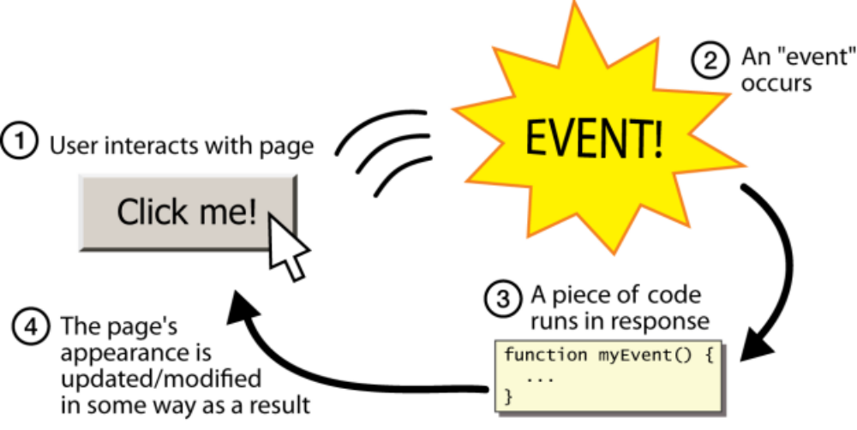
Event-driven
Programming
Main body of
the program is an event loop. Like this:
do {
e = getNextEvent();
// process event e;
} while (e != quit)
Fall 17 CSCI 2600, A Milanova

Slide 36
GUI Events and Listeners
event: an object that represents the user’s interaction with a GUI component; event can be “handled”
listener: an object that waits for events and handles them
  To handle an event, attach a listener to a component
  The listener will be notified when the event (e.g., button click) occurs
What design pattern is this?
Notes:
GUI driven programs are a prime example of event driven programs.

Slide 37
Kinds of Events (GUI and other)
Mouse: move/drag/click, mouse button press/release
Keyboard: key press/release, sometimes with modifiers like shift/control/alt
Touchscreen: finger tap/drag
Joystick, drawing tablet, other device inputs
Window resize/minimize/restore/close
Network activity or file I/O (start, done, error)
Timer interrupt (including animations)

Slide 38
Event Hierarchy
import java.awt.event.*
EventObject
AWTEvent (AWT)
ActionEvent
TextEvent
ComponentEvent
FocusEvent
WindowEvent
InputEvent
KeyEvent (Keyboard)
MouseEvent (Mouse move/drag, etc.)
An action that has occurred
on a GUI component
Button, menu, check box,
text box

Slide 39
Event Objects
Event object contains information about the event
  Info about GUI component that triggered the event
  Other information depending on the event. E.g.,
    ActionEvent – text string from a text selection box
    MouseEvent – mouse coordinates
action event: an action that has occurred on a GUI component. The most common Event type in Swing
  Button or menu clicks
  Check box checking/unchecking, etc.
Represented by class ActionEvent
Handled by objects that implement interface ActionListener

Slide 40
Events are Handled by Listeners
Implementing a listener
public class MyListener implements ActionListerner {
public void actionPerformed(ActionEvent event) {
// code to handle event here
}
}
JButton and other graphical components have this method:
/** Attaches a given listener to be notified of clicks and events that occur
on this component. */
public attachActionListener(ActionListener al)
Fall 17 CSCI 2600, A Milanova

Slide 41
EventListerner Hierarchy
import java.awt.event.*
EventListener
AWTEventListener
ActionListener has actionPerformed(…)
TextListener
ComponentListener
FocusListener
WindowListener
KeyListener has keyPressed(…)
MouseListener has mouseClicked(…)

Slide 42
EventListener Hierarchy
When an event occurs, the appropriate method specified in the interface is called
  When an action event (e.g., a button click) occurs, actionPerformed gets called on the attached (i.e., registered) Listeners
An event object is received as parameter to the event listener method
  actionPerformed(ActionEvent e)
Fall 17 CSCI 2600, A Milanova

Slide 43
JButton
JButton(String text)
Creates a new button with given string as text
String getText() and void setText(String text) - get and set button’s text, respectively
Create a Jbutton, add it to window, create an object that implements Action Listener, attach it to the button

Slide 44
Decoding Events
A single button listener can handle several buttons. How to tell which is which?
An ActionEvent has a getActionEvent method that returns (for a button) the “action command” string. Default is the button name. It is better to set to a specific string, which will remain the same even if UI (and button name) changes
E.g.,: …csci2600/handouts/ButtonDemo1.java
Fall 17 CSCI 2600, A Milanova

Slide 45
Aside: Nested Classes
Event listeners are often defined as nested classes, mostly as inner classes inside a GUI
Nested class: A class defined in another class
  static nested class
  non-static nested class (known as inner classes)
Inner classes are hidden from other classes
Inner objects can access the instance fields and methods of their outer object
Fall 17 CSCI 2600, A Milanova

Slide 46
Nested Class Syntax
public class OuterClass {
…
// Static nested class
// Same as top-level class, nested for convenience
static private class NestedClass { … }
// Non-static nested class (inner class)
// A different class for each instance of Outer
private class InnerClass { … }
}
Fall 17 CSCI 2600, A Milanova
Notes:
A static nested class is just the same (behaviorally) as a top-level class

Slide 47
Nested Class Syntax
If private, only the outer class can see the nested class or create objects of it
Each inner object is associated with the outer object that created it, so it can access/modify that outer object’s methods/fields
  Can refer to the outer object as OuterClass.this
Fall 17 CSCI 2600, A Milanova

Slide 48
Anonymous Inner Classes
Use-once classes
Define a new class directly in the new expression
Specify base class to be extended or interface to be implemented
Override or implement needed methods
If class starts to be complicated, use an ordinary class!
E.g.: …/csci2600/handouts/ButtonDemo2.java

Slide 49
Anonymous Inner Class Syntax
new expression to
create class instance
button.addActionListner(new ActionListner() {
public void actionPerformed(ActionEvent e) {
doSomething()
}
}
)
Base class or interface
extended
Method call parameters
Implementation of method for
this anonymous class
Brackets surrounding the
new class definition
Fall 17 CSCI 2600, A Milanova
Notes:
Listeners are often “use once” classes, so anonymous inner classes are a good option.

Slide 50
Java 8 Lambdas
In Java 8 ActionListener is called a “functional interface”, i.e., interface with only one method
Can replace bulky anonymous inner class
  button.addActionListener(e ->
  System.out.println("Handled by
  Lambda listener"));
  or our example,
  button.addActionListener(e ->
  doSomthing());
Fall 17 CSCI 2600, A Milanova

Slide 51
Outline of Today’s Class
Organization of the Java Swing/AWT library
  Components and containers
  Layout managers
  Graphics and drawing
Events
  Event objects
  Event listeners
Anonymous inner classes
Interaction between UI and program threads
Fall 17 CSCI 2600, A Milanova

Slide 52
Program Thread and UI Thread
Your program and the UI run in concurrent threads
All UI actions happen in the UI thread
  Including callbacks:
  paintComponent, actionPerformed
After event handling, you may call repaint if paintComponent needs to run
  Do not try to draw anything from inside the event handler!
Fall 17 CSCI 2600, A Milanova

Slide 53
Program thread and UI thread
program
window manager (UI)
Your program and window manager run concurrently
It’s ok to call repaint() from an event handler but never call paintComponent()
actionPerformed(e)
repaint()
paintComponent(g)
Fall 17 CSCI 2600, A Milanova

Slide 54
Working in the UI Thread
Event handlers should not do a lot of work. Why?
  If event handler does a lot of work, interface will appear to freeze up
  If there is a lot to do, the event handler should set a bit that the program thread will notice. Then do the heavy work back in the program thread
Fall 17 CSCI 2600, A Milanova

Slide 55
Fall 17 CSCI 2600, A Milanova

Slide 56
Components, Events, Listeners and the Observer pattern
Model view controller (just another name for the Observer pattern) comes up a lot…
One possible design:
  A model class (e.g., Sale) is the observable
    When Sale changes, it notifies its observers
  A Component, (e.g., a class that extends JFrame) is the observer (this is achieved by also implementing some Listener interface)
Fall 17 CSCI 2600, A Milanova

Slide 57
Where is the observable?
Where is the observer?
{ propertyListeners.add(lis); }
Sale
addPropertyListener(PropertyListener lis)
publishPropertyEvent(name,value)
setTotal(Money newTotal)
for each pl in propertyListeners
pl.onPropertyEvent
(this,name,value);
notify()
propertyListeners
*
<<interface>>
PropertyListener
onPropertyEvent(source, name, value)
update()
{ if (name.equals(“sale.total”))
saleTextField.
setText(value.toString())
}
SaleFrame1
onPropertyEvent(source, name,value)
initialize(Sale sale)
{ sale.addPropertyListener(this); }
SaleFrame1 extends JFrame

Slide 58
JPanel
Observer
Observable
GUIPanel
path
update(arg)
paintComponent(g)
observers
Model (Façade)
path
getPath(start,end)
graph
Your
Graph,
other
// compute path
// then notify observer
// GUIPanel, push path info:
setChanged();
notifyObservers(…);
// get path from arg
// path was pushed by model
repaint();
model
listeners
MyListener
actionPerformed()
Button
widgets
Widgets
(start, end
building)
// retrieve start, end from
// GUI widgets
model.getPath(start,end)

